Slide 1

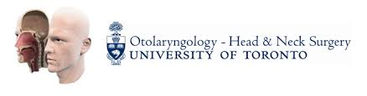

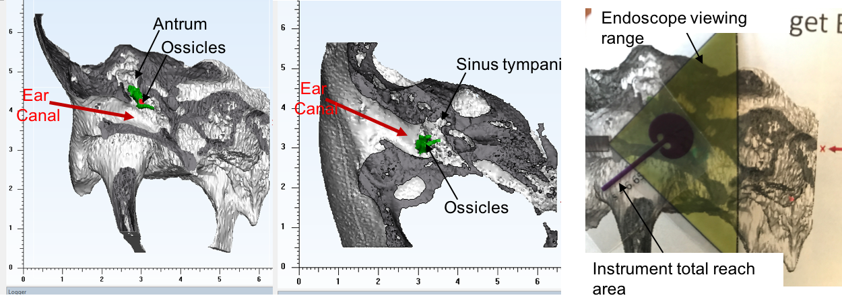
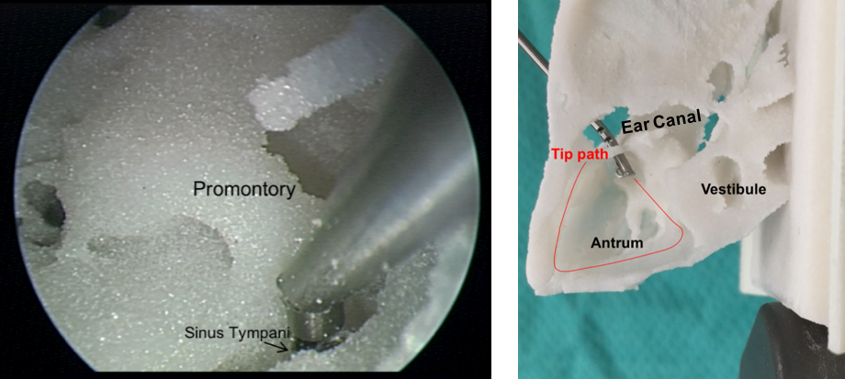
Design of Controllable Flexible Instruments to Facilitate Endoscopic Ear Surgery
arushri.swarup@mail.utoronto.ca
Arushri Swarup^{1,2,3}, Adrian L. James³
¹Department of Otolaryngology – Head and Neck Surgery, Faculty of Medicine, University of Toronto, Toronto, ON, Canada
²Centre for Image Guided Innovation and Therapeutic Intervention, The Hospital for Sick Children, Toronto, ON, Canada
³Institute of Biomaterials and Biomedical Engineering, University of Toronto, Toronto, ON, Canada
REB #s: 1000033566, 1000055626
Introduction: Transcanal endoscopic ear surgery (TEES) has undergone a surge of enthusiasm in recent years due to the benefits of minimally invasive surgery and clearer access to the tympanic membrane and recesses of the tympanic cavity^{1, 2, 3, 4}. However, due to the one-handed surgical technique required for TEES, the surgery is challenging especially in children who have a narrower ear canal^{5, 6, 7}. Otologic instruments, traditionally developed for two-handed surgery with operating microscopes, are not necessarily optimized for the TEES environment. To further advance TEES, it is important to thoroughly understand the limitations of current technology and instruments as well as the specific challenges that surgeons face.
Objective: to design instruments to facilitate the challenges experienced during transcanal endoscopic ear surgery (TEES).
Defining the Challenges of TEES
Development of a New Instrument for TEES
A needs analysis study determined that the most challenging aspect of TEES is reaching structures visualized by the endoscope.
An instrument was designed, prototyped and tested to reach structures visualized by the endoscope.
Reaching Solution: instrument tip is a “wrist” made by cutting notches into nitinol superelastic metal⁸. The tip can bend by pulling on a cable anchored at the tip. The geometry of the notches dictates the shape of bending. Simple, rectangular notches allow for a flexible tip. The notch geometry can be configured such that the same bending angle can be reached, while achieving a stiffer tip that can dissect tissues more reliably⁹.
Instrument Design:
Instrument Tip: “Wrist”
Reaching Problem: current instruments cannot reach all structures visualized by the endoscope without the removal of bone.
Patient CT scans were used to determine the appropriate radius of curvature and arc length of the wrist to reach target anatomy, including the antrum and sinus tympani where cholesteatoma is usually found and inaccessible without removing bone. The desirable bending angle is 135º which allows the tip to reach the boundary of the endoscope viewing angle.
Instrument Prototype:
Needs Analysis Study:
Study Findings:
Reaching structures visualized by the endoscope yielded the greatest need for better instruments. As per the Wilcoxon method for pairwise comparisons, reaching structures visualized by the endoscope and dissection and removal of cholesteatoma yielded significantly greater need for better instrumentation, p<0.05.
The qualitative comments called for instruments that can reach structures that are not reachable by current instruments, dissect and remove cholesteatoma, bone removal, and control bleeding.
The tip was laser cut out of nitinol into the geometry of the contact-aided compliant mechanism. It was attached to a handle using the components shown. The cable was attached to the tip and anchored inside the finger piece so that when the finger piece is rotated (while the handle is held like a pen, similar to current ear surgery instruments) the tip can bend.
Instrument Testing:
The instrument was tested using an endoscope inside 3D printed patient temporal bone models generated from the CT scans. It was possible to reach the sinus tympani and antrum. Future work involves further testing of different-sized tips in more 3D printed models.
Discussion and Conclusions
The Needs Analysis questionnaire was designed to expand upon a survey by Lea et al. that presented the current status of endoscopic ear surgery in Canada by analyzing the specific technical difficulties experienced by TEES surgeons¹⁰. Reaching structures visualized by the endoscope was rated as the TEES challenge with the greatest need for better instrumentation. In order to address this need, a new instrument was designed, prototyped and tested to reach structures by using this technology to bend inside the ear anatomy. By using engineering design techniques and patient CT scans to develop the instrument, it is envisaged that the final instrument will be safe and effective to successfully reach various structures visualized by the endoscope. Future work involves further testing of the tip to ensure it can safely encounter the tissue forces experienced during surgery, orient a laser fibre safely and effectively, and reach the desired targets within the middle ear without significant bone removal and ultimately facilitate endoscopic ear surgery.
References
1. Cohen MS, Landegger LD, Kozin ED, Lee DJ. Pediatric endoscopic ear surgery in clinical practice: Lessons learned and early outcomes. Laryngoscope. 2015:732-738. 2. Kanona H, Virk JS, Owa A. Endoscopic ear surgery: A case series and first United Kingdom experience. World J Clin cases. 2015;3(3):310-317. 3. Badr-el-dine M. Instrumentation and Technologies in Endoscopic Ear Surgery. Otolaryngol Clin NA. 2013;46(2):211-225. 4. Bennett ML, Zhang D, Labadie RF, Noble JH. Comparison of Middle Ear Visualization With Endoscopy and Microscopy. Otol Neurotol. 2016;37:362-366. 5. Yong M, Mijovic T, Lea J. Endoscopic ear surgery in Canada : a cross-sectional study. J Otolaryngol - Head Neck Surg. 2016:1-8. 6. Prasad SC, Giannuzzi A, Nahleh EA, Donato G De, Russo A, Sanna M. Is endoscopic ear surgery an alternative to the modified Bondy technique for limited epitympanic cholesteatoma? Eur Arch Oto-Rhino-Laryngology. 2016;273(9):2533-2540 7. Dahm C, Shepherd RK, Clark GM. The Postnatal Growth of the Temporal Bone and its Implications for Cochlear Implantation in Children. Acta Otolaryngol (Stockh). 1993; 4-39. 8. Eastwood KW, Francis P, Azimian H, Swarup A, Looi T, Drake JM, Naguib HE. Design of a Contact-Aided Compliant Notched-Tube Joint for Surgical Manipulation in Confined Workspaces. ASME. J. Mechanisms Robotics. 2017;():. [accepted manuscript] 9. Qiao L and Souweidane M. M. Purely endoscopic removal of intraventricular brain tumors: A consensus opinion and update, Minim. Invasive Neurosurg., 2011; 54(4) 149-154. 10. Yong M, Mijovic T, Lea J. Endoscopic ear surgery in Canada : a cross-sectional study. J Otolaryngol - Head Neck Surg. 2016:1-8.
Notes:
Since we’re submitting the needs analysis to otology and neurotology, how much of the results should we present here? Sentac won’t publish the poster, so this stuff won’t be published, which is what I’ve agreed upon in the submission
Label ear canal and instrument for reacing problem
Bring along an instrument

Slide 2

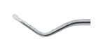
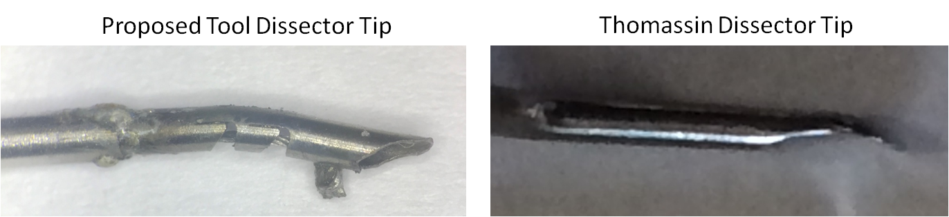
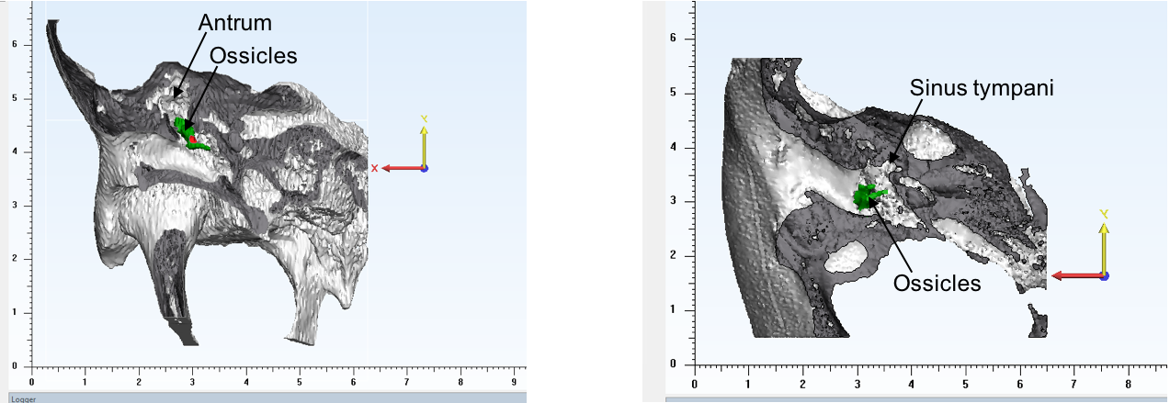
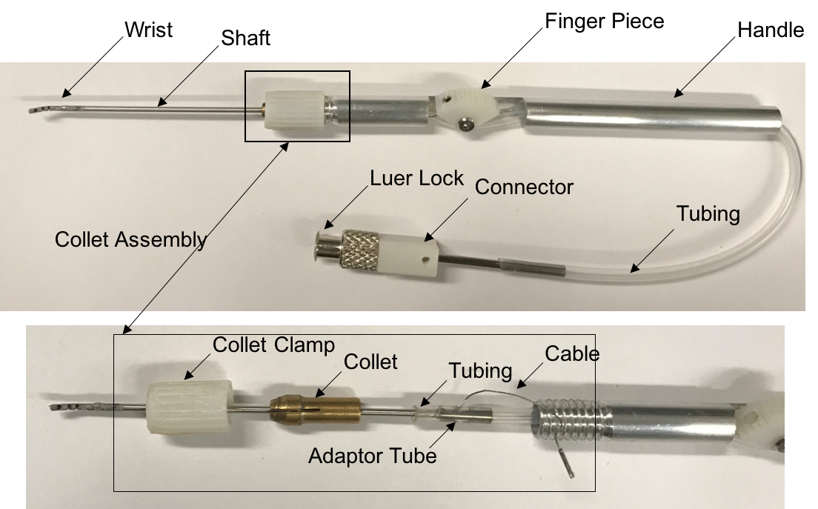
Design
Prototype
Interviews with 5 local otologists
TEES Experience:
Percent of TEES Cases:
0%
Up to 50%
50-90%
More than 90%
Cable attached to tip
Pilot questionnaire
TEES skills course
Use of specialized TEES Instruments?
Yes
No
Test
Cross-sectional mixed methods study questionnaireç
Visual Analog Scale:
Rate need for better instrumentation to address the following TEES challenges:
Reaching structures visualized by the endoscope
Dissection and removal of cholesteatoma
Cutting bone
Bleeding control
Keeping the endoscope lens clean
Positioning a graft
Thomassin Dissector, double bend
51 international TEES Surgeon responses
Ear Canal
X
Non-parametric data analysis: Kruskal Wallis H-Test
Wilcoxon Method
P<0.05 significant
“Are there any other instruments that you would like to see modified or developed for endoscopic ear surgery? Please give examples”
Target
Need for Better Instrumentation vs. TEES Challenge

